Slide 1


PQ| PP| PBI | DAX Case Study Project
Dana Drouskin

Slide 2
Project Overview
Performing an ETL process to utilize given datasets into a star schema design using Power Query and M language technique.
01
Creating a tabular model using Power Pivot to enable addressing business questions meaningfully, effortlessly, and quickly by end users.
02
Developing reports and data visualizations using Power BI and DAX language.
03

Slide 3
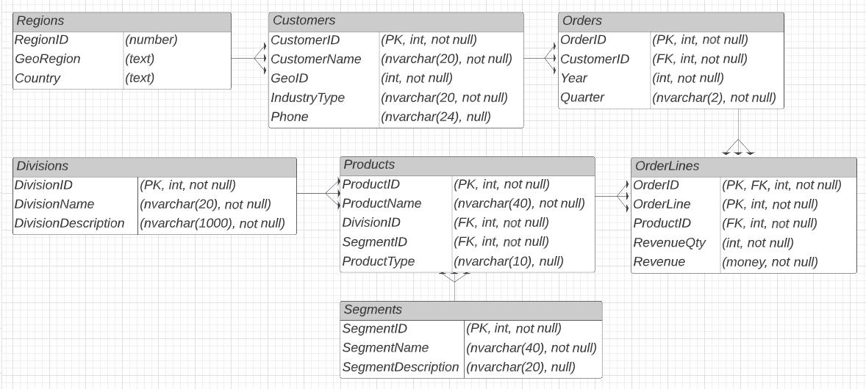
Datasets
An SQL file which contains the following 6 tables:
Customers table – 5 columns, 94 rows
Divisions table – 3 columns, 3 rows
OrderLines table – 5 columns, 12,973 rows
Orders table – 4 columns, 571 rows
Products table – 5 columns, 16 rows
Segments table – 3 columns, 5 rows
A CSV file which contains 1 table:
Regions table – 3 columns, 68 rows

Slide 4
Data Exploration using Dax Queries
There are 94 customers, categorized by Industry Type as either End-Users (31) or Distributors (63).
Customers are in 68 countries, in either one of the 3 regions: Americas (5 ) , APAC (28), or EMEA (61).
There are 3 divisions: Life Insurance, Health Insurance, and Property Insurance.
There are 16 products characterized by:
3 product types: Premium, Gold, or Upgrades.
Customers payments are made on a quarterly basis.
Each order normally contains multiple order lines, where each line presents either a positive or negative revenue per a specific product.
The historical data gathered over the course of 3 years, from 2011 to 2013.
5 segments: Health Care, First-degree relative, Second-degree relative, Third-degree relative, or Apartment

Slide 5
Assumptions & Issues
The company incur positive revenues from insurance policy premiums, while negative revenues are expenses which consist of paid claims and/or policy cancellations.
Target profits desired is 15% more than previous period actual profits, except of 2011, which is the first year available per data sources, therefore targeted profits for that year are the actual profits (in other words, no target profits for 2011 due to lack of previous data to base it on).
The dataset presents orders that are based on a quarterly basis (day and month are not available). In order to enable relationship between SalesFact and Dim Dates tables we created a consistent pseudo date for each order, based on the given quarter and year (each order placed on 1st quarter was set to be represented by the 1st day of January, 2nd quarter was set to be represented by the 1st day of April, etc.).
Each order typically contains multiple order lines; therefore, their combined values were used to create a surrogate key for the Dim Orders table.

Slide 6
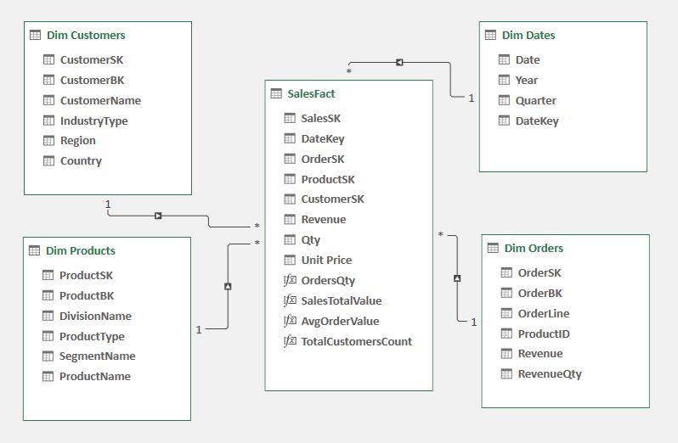
Dimensional Modeling Star Schema Design
Moving into a dimensional modeling star schema design, a SalesFact table was identified, as well as Dim_Orders, Dim_Customers, Dim_Products and Dim_Dates, and their relationships.

Slide 7
ETL Process:
Getting the 2 data sources into PQ
Renaming queries as per SalesFact and Dimensions
Taking care of nulls
Transformations:
Adding indices
Renaming, reordering, removing, merging, duplicating, and splitting columns
Adding conditional and custom columns
Merging queries
Changing data types
Loading the model into PP

Slide 8
Calculated Column & Measures in PP:
Unit Price
=SalesFact[Revenue]/SalesFact[Qty]
Orders Quantity
=CALCULATE( DISTINCTCOUNT(SalesFact[OrderSK]), FILTER(SalesFact, SalesFact[Revenue] > 0))
Total Customers Count
=DISTINCTCOUNT(SalesFact[CustomerSK])
Sales Total
=CALCULATE(SUMX(SalesFact, SalesFact[Revenue]), SalesFact[Revenue] > 0)
Avg Order Value
=DIVIDE(SalesFact[SalesTotalValue], [OrdersQty], 0)

Slide 9
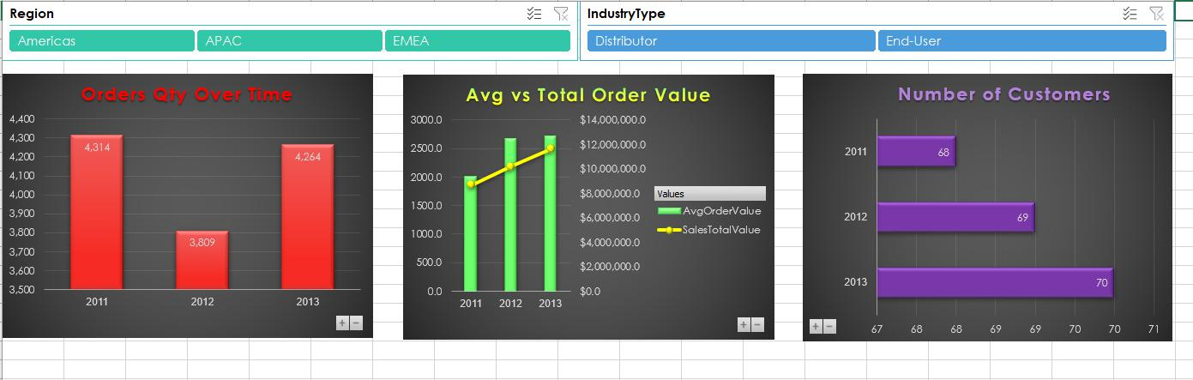
Orders Dashboard in PP
Number of customers per year has insignificantly grown by 1 customer each year.
Between 2011-2012, the number of orders decreases by 505 orders, yet the total sales amount increases by $1.6M.
Between 2012-2013, the number of orders increases by 455 orders, and the total sales amount increases by $1.4M.

Slide 10
Implementing the Model inPBI -
Renaming tables & columns names
Hiding and formatting columns
Measures for example:
CY Claims = var MaxY = max(Dates[Date].[Year]) return calculate(-1*sumx(filter(sales, Sales[Revenue] < 0), Sales[Revenue]), Dates[Date].[Year] = MaxY)
CY % Gross Margin = divide('Measures_Table'[CY Profits], 'Measures_Table'[CY Sales], 0)
YOY Sales Qty = var MaxY=MAX(Dates[Date].[Year]) return divide((Measures_Table[Sales Qty]-Measures_Table[LY Sales Qty]), Measures_Table[LY Sales Qty], 0)
Using features such as: navigation panel, buttons (BACK), drill up/down/through, tooltip
Creating a What If analysis
Using appropriate visualizations, slicers, filters and determining correct interactions
Using Dax Queries to test measures before creating them in PBI
Using Tabular Editor to create KPI’s
Creating user roles
Creating bookmarks to work with the BACK buttons
Creating a measures table organized in folders by subjects.
Creating hierarchies

Slide 11
Hierarchies
Location:
Region
Country
Product:
Division
Segment
Product Type
Product Name
Date:
Year
Quarter
Month
Day

Slide 12
Roles
Americas Manager
[Region] = "Americas"
APAC Manager:
[Region] = "APAC"
EMEA Manager:
[Region] = "EMEA"

Slide 13
The Dashboard
We created a dashboard with 8 pages to navigate through:
The Profits Analysis page allows managers to keep track of current state and trends of profitability.
The Divisions Analysis page is designed to provide a comparison of the different divisions to each other in terms of Sales and Claims performance, and trends over time.
The Products Analysis page is to compare products in the same segment to each other, and over time, in terms of Sales, Claims, Profits and performance against Target Profits.
The Industry Type Analysis page is to compare type of customers in terms of Orders, Sales and Claims, as well as observing Profits trends over time.
The Regions Analysis page provides perspectives of Sales, Claims and Profits amounts by customers per different regions and countries.
The Customers page analyzes the percentage of repeat/new customers over time and per a time period. This analysis can help managers to maintain a certain ratio between repeat and new customers which is important for company’s health.
The Risk page presents calculations of Claims Risk Grade, which can be examined per the company at high level, but also per each individual customer, per customer groups, or regions.
The What If… Analysis page allows analyzing scenarios of increase/decrease in either price or quantity per a product and calculates the impact it will have over total sales. Calculations are based on historical data.
We added the following hidden pages: 2 pages to drill through and 1 tooltip:
The Customer Orders & Claims page enables drilling through customer’s orders and claims reports per selected time period (the reports present orders/claims per a certain year, or parts of the year, depending on selected Years/Quarters in time filter on the page navigating from).
The Regional Opportunities by Division/Product page enables drilling through potential marketing opportunities of certain divisions/products in different regions/countries to customers already acquired in previous periods. This analysis follows the notion that selling to already acquired customers is less costly and improves marketing return over investment.
The tooltip page presents the top customer per country in terms of Profits.

Slide 14
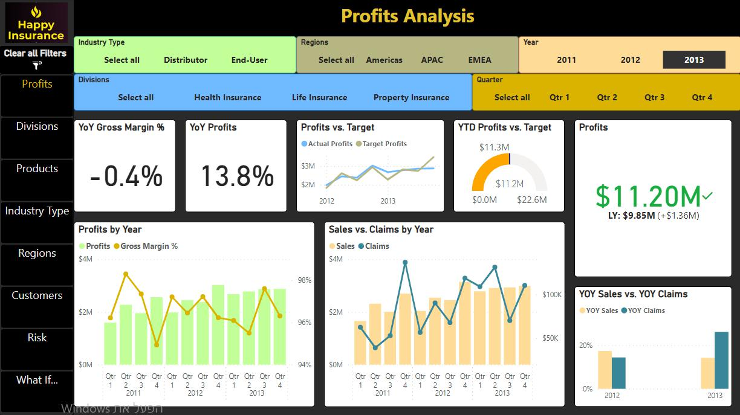
The Profits Analysis page includes: 5 slicers to enable zooming in on the data by Years/Quarters, Divisions, Regions, and Industry Type. A Profits KPI card with comparison to last year’s profits. A YTD Profits vs Target gauge with colors changing based on distance from reaching the targeted profits goal. Gauge colors (Target Profits) = switch( TRUE(), [YTD Profits] <= (divide([Target Profits (all quarters)], 3)), "Red", [YTD Profits] < [Target Profits (all quarters)], "Orange", "Green") A line chart for Profits vs. Target trends over time. YoY Profits and YoY Gross Margin % cards. Combo charts to present trends of Profits vs. Gross Margin % and Sales vs. Claims. A bar chart to compare YoY Sales with YoY Claims.

Slide 15
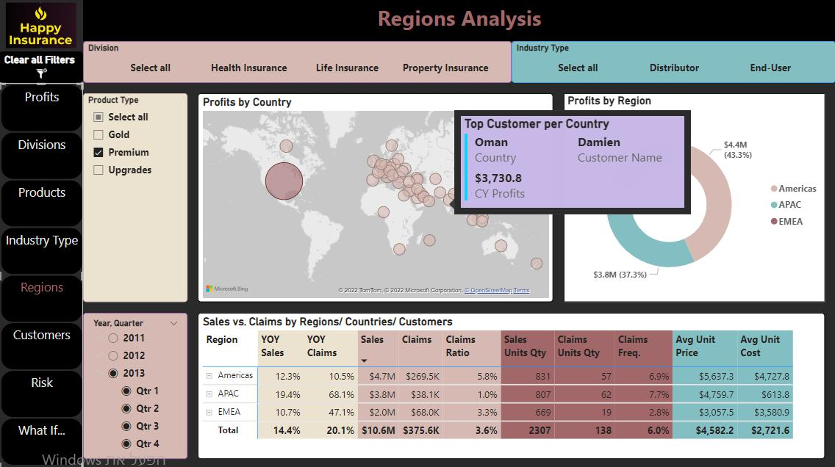
The Regions Analysis page includes: 4 slicers to allow an even narrower perspective by Divisions, Years/Quarters, Industry Type, and Product Type. A Profits by Country map with location by country and bubble size in accordance with profits amount. Hovering over each country, a tooltip presents the top customer in that country in terms of profits. Profits by Region donut chart demonstrates the ratio of profits by the different regions. A matrix table breakdown of Sales and Claims measures by Regions. Each region can be expended to present its countries, and countries can be expended to present its customers. There is an option to drill through on region to the Regional Opportunities Analysis page. There is an option to drill through on customers names to the Customer Orders & Claims Reports page.

Slide 16
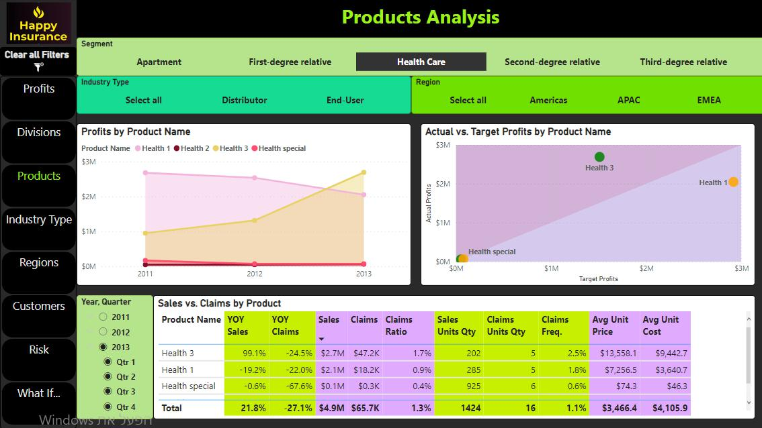
The Products Analysis page includes: A main slicer for navigating between the different segments to present the products belong to each segment. 2 additional slicers to enable zooming in on the data by Industry Types and Regions. Profits by Product Name area chart to visualize trends over time and volume differentiation. A scatter chart to visualize each product performance of actual profits vs. target profits. A ratio line helps to see which products performed above or below target, but also each product’s marker is being colored per a dynamic measure – green for reaching the target, orange – for getting close to target, and red – for greatly missing the target. Target Profits reached colors = switch( TRUE(), [CY Profits] <= (divide([Target Profits], 3)), "Red", [CY Profits] < [Target Profits], "Orange", "Green") A table breakdown of Sales and Claims measures by Product Name. Additional Years/Quarters slicer to present data per different time periods.

Slide 17
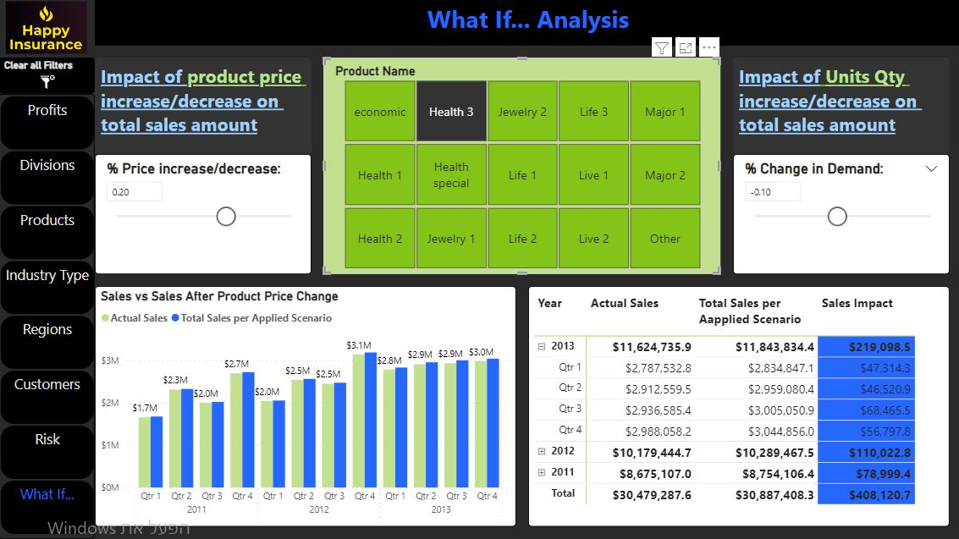
The What If Analysis page includes: Slicers for % change to be applied to either product price or quantity, or both. The % change may be applied in 5% increments at a time. A slicer with all possible products to which changes may be applied and examined. A clustered column chart and a matrix table to visualize actual total sales vs. the scenario impact on total sales. Total Sales (ProductName Scenario)** = Var ProductSelectedName = SELECTEDVALUE(Products[Product Name]) var ProductSelectedSales_Without_Percentage = CALCULATE(SUMX(FILTER(Sales, Sales[Revenue]>0), Sales[Revenue]), FILTER(Products, Products[Product Name] in {ProductSelectedName}), all(Products[Product Name])) Var ProductSelectedSales_With_Percentage = CALCULATE(SUMX(Filter(Sales, Sales[Revenue]>0), ((Sales[Qty]*(1 + 'Demand Scenario'[Demand Scenario Value]))*(Sales[Unit Price])*(1 + 'Pricing Scenario'[Pricing Scenario Value]))),FILTER(Products,Products[Product Name] in {ProductSelectedName}),ALL(Products[Product Name])) Var TotalSales_Without_ProductSelectedSales = Calculate(SUMX(filter(Sales, Sales[Revenue]>0), Sales[Revenue]), ALL(Products[Product Name])) - ProductSelectedSales_Without_Percentage Return TotalSales_Without_ProductSelectedSales + ProductSelectedSales_With_Percentage

Slide 18
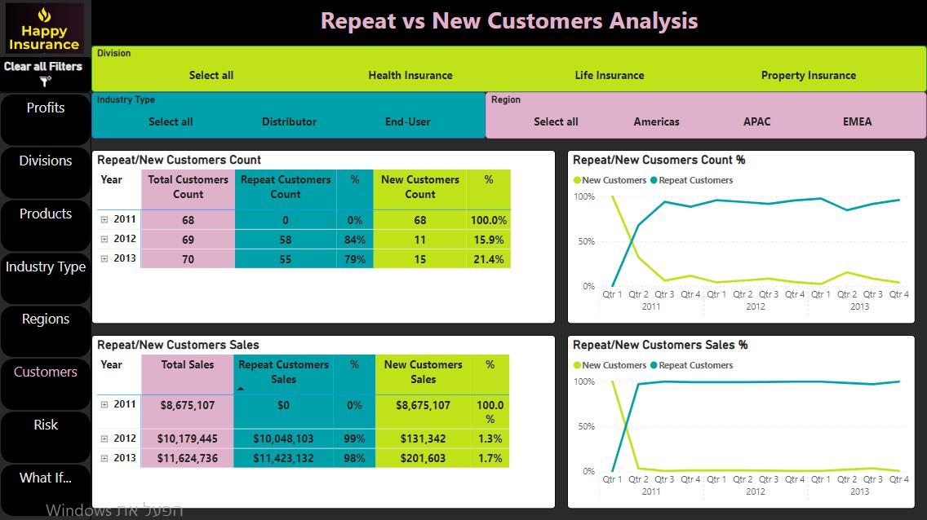
The Repeat vs. New Customers Analysis page includes: 3 slicers to zero down on the measures by Divisions, Industry Type and Regions. A matrix table with calculations of repeat/new customers sales amount/ customers count percentage out of total sales amount/ total customers count, along with complementary line charts representation of the data over time. The years' view can be expended to quarters as well.
DEFINE MEASURE Customers[Count_All_Customers] = DISTINCTCOUNT(Sales[CustomerSK]) MEASURE Customers[New_Customers] = var CurrentCust = VALUES(Sales[CustomerSK]) var CurrentDate = min(Dates[Date]) var PastCustomers = CALCULATETABLE( VALUES(Sales[CustomerSK]), all(Dates[Date]), Dates[Date]<CurrentDate) var New_Customers = EXCEPT(CurrentCust, PastCustomers) return COUNTROWS(New_Customers) MEASURE Customers[New_Customers_Sales] = var CurrentCust = VALUES(Sales[CustomerSK]) var CurrentDate = min(Dates[Date]) var PastCustomers = CALCULATETABLE( VALUES(Sales[CustomerSK]), all(Dates[Date]), Dates[Date]<CurrentDate) var New_Customers = EXCEPT(CurrentCust, PastCustomers) return SUMX(New_Customers, [Total Sales]) MEASURE Customers[Repeat_Customers_Count] = [Count_All_Customers]-[New_Customers] MEASURE Customers[Repeat_Customers_Sales] = [Total Sales]-[New_Customers_Sales]
EVALUATE SUMMARIZECOLUMNS( Dates[Date], "Count_All_Customers", [Count_All_Customers], "Total Sales", [Total Sales], "Repeat_Customers_Count", [Repeat_Customers_Count], "Repeat_Customers_Cnt_%", divide([Repeat_Customers_Count], [Count_All_Customers], 0), "Repeat_Customers_Sales", [Repeat_Customers_Sales], "Repeat_cust_sales_%", divide([Repeat_Customers_Sales], [Total Sales], 0), "New_Customers", [New_Customers], "New_Cust-cnt-%", divide([New_Customers], [Count_All_Customers], 0), "New_Customers_Sales", [New_Customers_Sales], "New_cust_sales_%", divide([New_Customers_Sales], [Total Sales], 0) ) ORDER BY Dates[Date] ASC

Slide 19
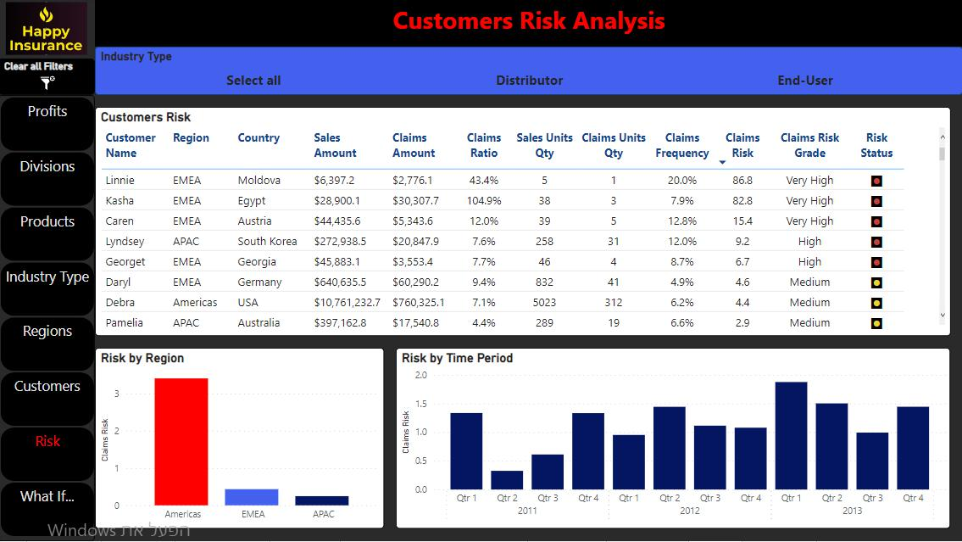
The Customers Risk Analysis page includes: A table with customers’ name and location. The claims ratio is calculated as the claims amount divided by the sales amount. The frequency ratio is calculated as the number of claimed units divided by the number of purchased units. The total claims risk is a multiplication of the above measures. A grading measure is provided as follows: below 1 = “Low” risk, between 1 and 5 = “medium”, between 5 and 10 = “High”, and above 10 = “Very High”. A risk KPI status provides visually convenient colors representation of the different grades. Bar charts visualize Risk by region and present the trend over time. An Industry Type slicer allows zooming in on a certain group of customers.
DEFINE MEASURE Customers[Sales amount (all times)] = CALCULATE(SUMX(Sales, Sales[Revenue]), Sales[Revenue] > 0, all(Dates[Date].[Date])) MEASURE Customers[Claims amount (all times)] = CALCULATE(-1 * SUMX(Sales, Sales[Revenue]), Sales[Revenue] < 0, all(Dates[Date].[Date])) MEASURE Customers[Sales Units Qty (all times)] = CALCULATE(SUMX(Sales, Sales[Qty]), Sales[Revenue] > 0, all(Dates[Date].[Date])) MEASURE Customers[Claims Units Qty (all times)] = CALCULATE(SUMX(Sales, Sales[Qty]), Sales[Revenue] < 0, ALL(Dates[Date].[Date])) MEASURE Customers[Claims Ratio (all times)] = DIVIDE([Claims amount (all times)], [Sales amount (all times)], 0) MEASURE Customers[Claims Frequency (all times)] = DIVIDE([Claims Units Qty (all times)], [Sales Units Qty (all times)], 0) MEASURE Customers[Claims Risk] = [Claims Ratio (all times)] * [Claims Frequency (all times)] * 1000 MEASURE Customers[Claims Risk Grade] = IF([Claims Risk] <= 1, "Low", IF([Claims Risk] <= 5, "Medium", IF([Claims Risk] <= 10, "High", "Very High")))
EVALUATE SUMMARIZECOLUMNS( Customers[Customer Name], "Total Sales amount", [Sales amount (all times)], "Total Claims amount", [Claims amount (all times)], "Total Sales Units Qty", [Sales Units Qty (all times)], "Total Claims Units Qty", [Claims Units Qty (all times)], "Claims Ratio", [Claims Ratio (all times)], "Claims Frequency", [Claims Frequency (all times)], "Claims Risk", [Claims Risk], " Claims Risk Grade", [Claims Risk Grade] ) ORDER BY Customers[Customer Name] ASC

Slide 20
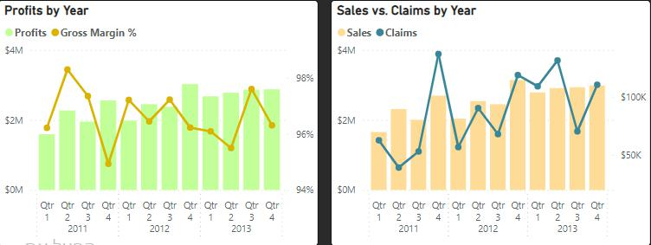
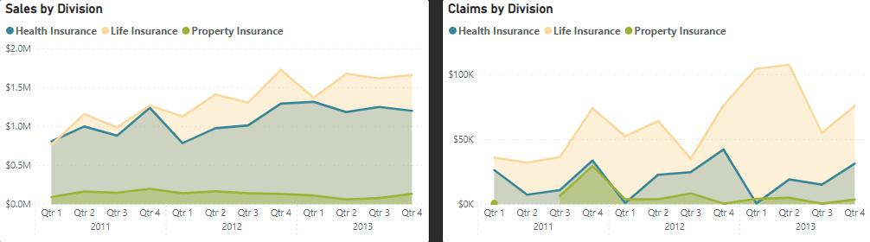
Insights – Profits & Divisions
Profits increased by 13.8% between 2012-2013 compared with 17.4% increase between 2011-2012.
The decline in profitability growth might be explained by the decline in YoY sales (from 17.3% in 2011-2012 to 14.2% in 2012-2013) and increase in YoY claims (from 14.4% in 2011-2012 to 26.1% in 2012-2013).
As the increase in YoY claims is stronger than the increase in YoY sales in 2012-2013, gross margin % declines in 2013 by 0.4%.
Over time, actual profits perform well vs. target, either exceeding the target, or coming very close to it. In the last quarter of 2013, however, actual profits fall behind target just over $600K.
Life Insurance division is dominant both in terms of sales and claims over time, with $6.3M sales and $342K claims in 2013.
Health Insurance division is also a major income channel with $4.9M in sales in 2013.
Health Insurance division claims ratio is consistently lower than the Life Insurance division claims ratio. In 2013 Health Insurance CR was 1.3% compared with Life Insurance CR of 5.4%.
Property Insurance division is rather small in comparison with the other two divisions. In 2013 it presented only $381K in sales, and a steep decline of 33.6% in profits.
Between 2012-2013, in terms of Profitability, Health Insurance division performs better than Life Insurance division, with Health Insurance increase of 0.9% in gross margin % vs. a 1.4% decrease of Life Insurance gross margin %.
The above might be explained by Health Insurance increase in YoY sales of 21.8% and a decrease in YoY claims of 27.1% (2012-2013) while Life Insurance demonstrated a stronger increase in YoY claims of 50.4% than its increase of YoY sales of 13.6% (2012-2013).

Slide 21
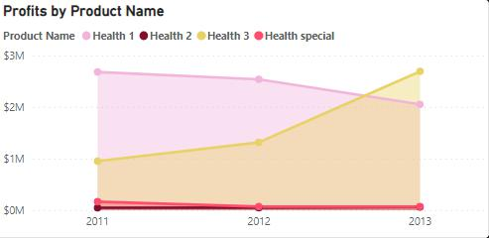
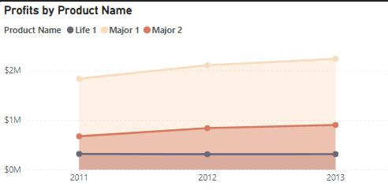
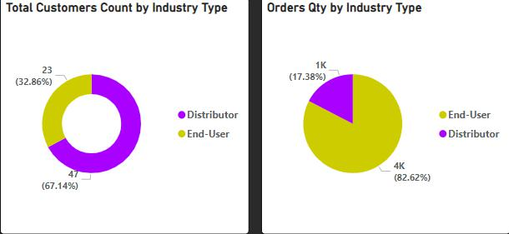
Insights – Products & Industry Types
In 2013:
Health3 is the most profitable product in the Health Care segment with $2.7M in profits. It’s the most profitable product among all products in all segment and divisions. In the Health Care segment, it is dominant by both distributors and end-users, as well as in the Americas and EMEA regions. In APAC, though, Health1 is being preferred over Health3, perhaps due to an avg unit price of $7K in that region, much lower than the $15.3K avg unit price of Health3 in APAC. Between 2011-2013, the only time it didn’t reach its target profits was in the 1st quarter of 2012.
Major1 is the most profitable product in the First-Degree Relative segment with $2.2M in profits.
economic is the most profitable product in the Third-Degree Relative segment with $982K in profits.
Live1 is the most profitable product in the Second-Degree Relative segment with $780K in profits.
Jewelry1 is the most profitable product in the Apartment segment with $228K in profits.
In 2013, there are significantly less end-users (33%) compared with distributors (67%), although end-users' sales ($8.6M) are much higher than distributors’ sales ($3M).
In both Americas and APAC there are less end-users who are bringing in more sales and claims than distributors.
In EMEA, however, distributors are dominant both in customers’ count (74%) and in sales amount ($1.7M) compared with end-users’ count (26%) and sales amount ($0.7M) . Nevertheless, end-users in the EMEA are still responsible for a higher claims amount and their claims ratio is much higher (5.9%) than claims ratio of end-users (2.4%).

Slide 22
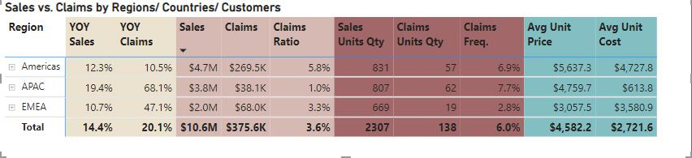
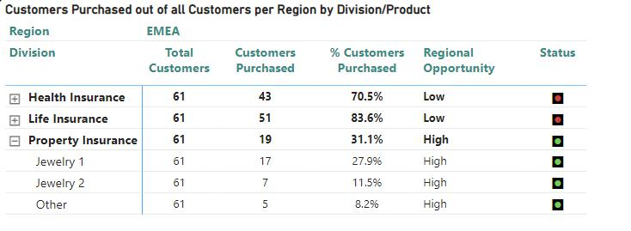
Insights – Regions & Regional Opportunity
In 2013:
The largest region in terms of profits is Americas with $4.8M, while EMEA is the smallest with $2.4M in profits.
Americas dominates the Health Insurance and Property Insurance divisions in terms of profits, while APAC dominates the Life Insurance division.
End-users in Americas and APAC are bringing in more profits vs distributors, while distributors in EMEA are bringing in much more profits vs end-users.
Products in the Property Insurance division has a high potential to marketing it to the company’s customers in the EMEA, as only 31.1% of this region’s customers are placing orders per these products.
There is a high potential to market Live2 product in Americas as 0% of the region’s customers is currently buying it.
There is a medium opportunity to market Health2 in Americas as 40% of the region’s customers is currently buying it.
There is a medium opportunity to market Jewelry1 in Americas as 60% of the region’s customers is currently buying it.
Jewelry2 has a high potential in Americas as only 20% of existing customers in the region buying it.

Slide 23
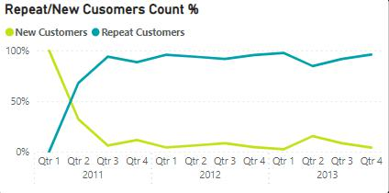
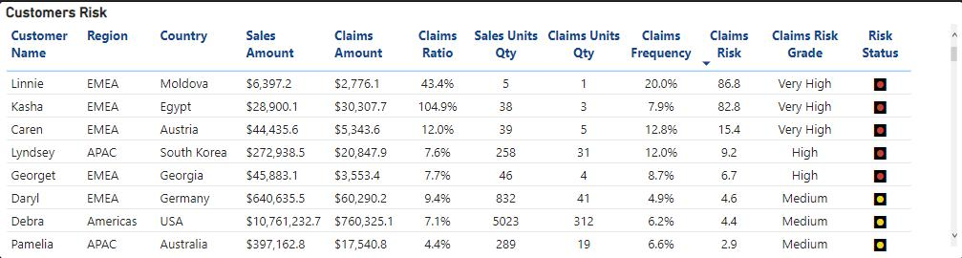
Insights – Customers & Risk
New Customers count is gradually dropping during the first year, 2011, and is consistently low (less than 10%) except for the 2nd quarter of 2013 with 15.4% new customers count.
Repeat customers are steadily responsible for more than 96% of sales amount ever since the 2nd quarter of 2011.
There are 3 customers with a “Very High” risk grade (Linnie, Kasha, and Caren), all are from the EMEA.
Risk is considered low in APAC (0.2 rank) and in the EMEA (0.4 rank), but Medium in Americas (3.4 rank).
The company is diverging between Medium and Low risk grades, with a tendency towards Medium rank.
Distributors present almost no risk in all regions, while end-users present higher risk grades, especially in the Americas and EMEA.

